Slide 1
Statistics in Sports: Baseball Overview
Zachary Binney, PhD MPH
Oxford college of emory university
Fall 2021

Slide 2
Roadmap
1. Sports Analytics History
“Culture Wars”
2. (Player Valuation) Analytics in Baseball:
Batting
Fielding
Pitching
3. What Makes a Good (Sports) Statistic?
Define. Your. Question!

Slide 3
Sports Analytics History

Slide 4
First Use of “Statistics” in Sports?
Who can push us back the farthest?
STOP!
DON’T LOOK AT FUTURE SLIDES YET.

Slide 5
First Use of “Statistics” in Sports?
Haven’t they always been there, in a sense?
Doesn’t everyone – including coaches and scouts – use them?
Jocks vs. nerds?
Culture war vs. actual disagreement on using numbers in sports
Matter of degree (literally and figuratively)
Outsiders vs. insiders

Slide 6
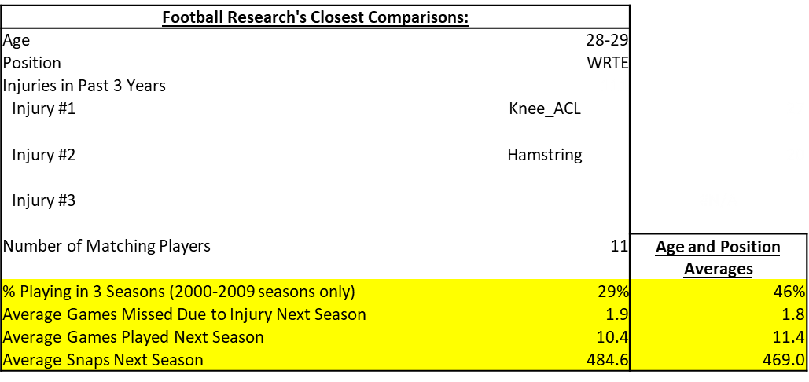
Analytics Culture War
It’s not (just) dumb nerds resisting jocks who “know how to do their job better”
“Nerd” = “Outsider”
Have to recognize we’re coming in to their house. Be humble, “there to help”
Try and integrate ourselves in existing culture/space while pressing for change. Tough balance!

Slide 7
Modern History of Statistics in Sports
DISCLAIMER: In no way comprehensive. Weighted towards sports I know more about (football, baseball)
Here’s a baseball history

Slide 8
Modern History of Statistics in Sports
Early Modern Era: 1970-2000ish
Statisticians, academics, and other “outsiders” argue they can improve sports with numbers

Slide 9
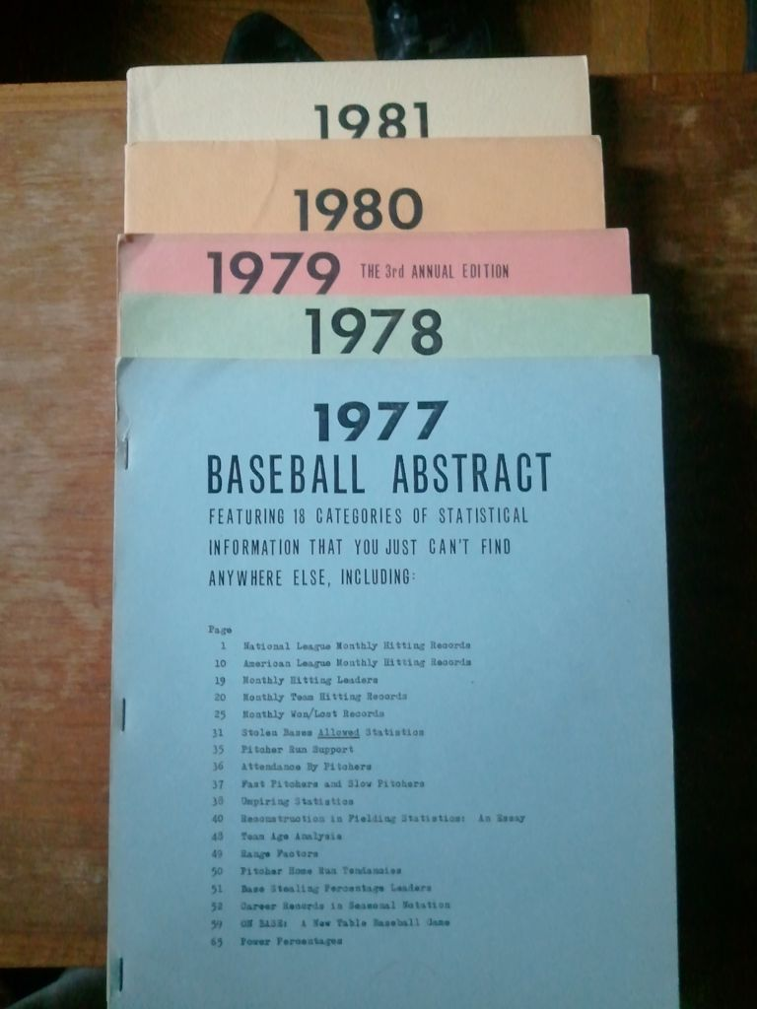
Modern History of Statistics in Sports
Early Modern Era: 1970-2000ish
“Operations research in football” – Carter & Machol, 1971
“On the optimal time to pull the goalie” – Morrison, 1976
Bill James Baseball Abstract – 1977
Rotisserie Leagues/fantasy baseball (by mail)
Source: https://homemlb.wordpress.com/2014/02/05/1977-new-candidates/

Slide 10
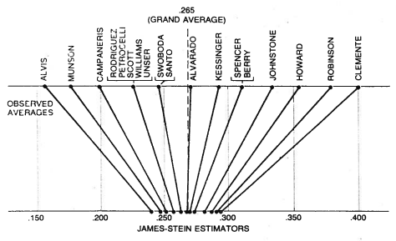
Modern History of Statistics in Sports
Early Modern Era: 1970-2000ish
“Stein’s Paradox in Statistics” – Efron and Morris, 1977
Hidden Game of Football – Carroll, Thorn, and Palmer, 1988
Source: https://statweb.stanford.edu/~ckirby/brad/other/Article1977.pdf

Slide 11
Modern History of Statistics in Sports
Turn of the Millennium: 2000-2015ish
Greater data availability
Internet, bloggers, public analyses → team hires
Public profile grows
Moneyball, 2003
Source:

Slide 12



Modern History of Statistics in Sports
Turn of the Millennium: 2000-2015ish
BaseballProspectus.com (1997)
Baseball-Reference.com (2000)
Pro-Football-Reference.com (2003)
FootballOutsiders.com (Aaron Schatz; 2003)
Basketball on Paper (Dean Oliver; 2004)
Sports Reference (Sean Forman; 2004; now includes basketball, hockey, soccer, college basketball/football)
Fangraphs (2005)
Advanced Football Analytics (Brian Burke; 2006-16)
Source: https://homemlb.wordpress.com/2014/02/05/1977-new-candidates/

Slide 13
Modern History of Statistics in Sports
Firehose/Player Tracking Era: 2015ish-Now
Proliferation of individual blogs, websites, independent sports analyses, sports analytics clubs
Massive increases in data for public but especially for private team work
Tracking data firehose; data engineers, architects
Team hiring accelerates (non-baseball 0 → some, baseball some → whole departments)
Source:

Slide 14
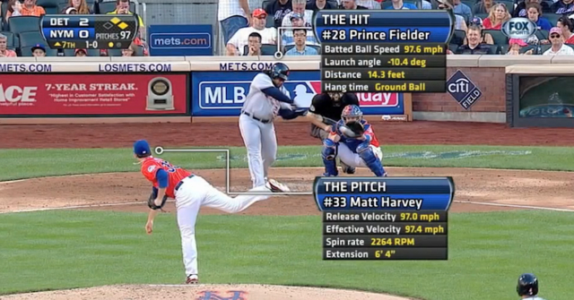
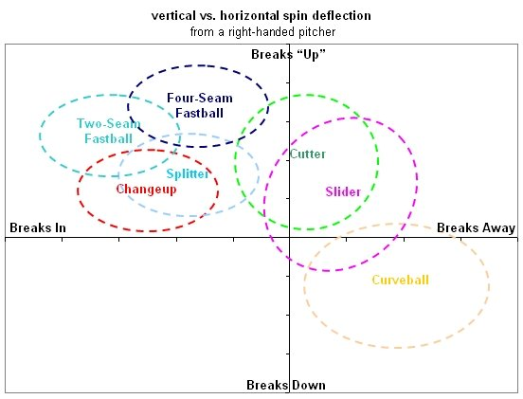
Modern History of Statistics in Sports
Firehose/Player Tracking Era: 2015ish-Now
Baseball: Statcast/Hawkeye
Previously Trackman, PitchF/X
Source: https://www.etcentric.org/mlbs-statcast-tech-could-revolutionize-the-game-of-baseball/; https://library.fangraphs.com/pitch-type-abbreviations-classifications/

Slide 15
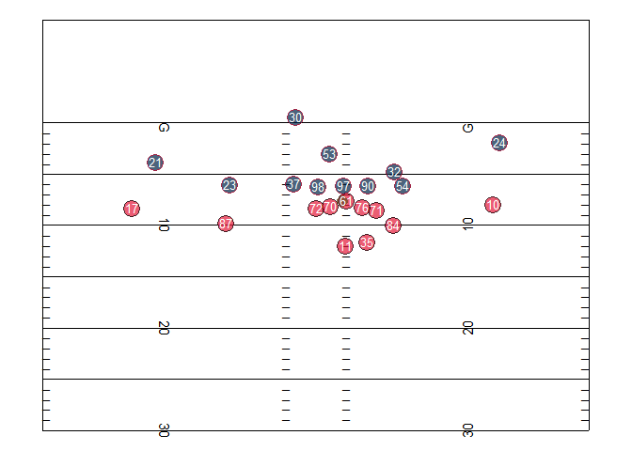
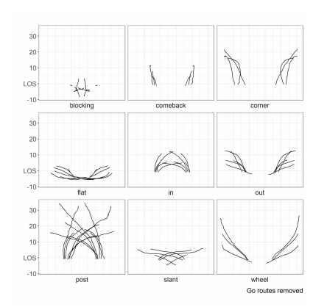
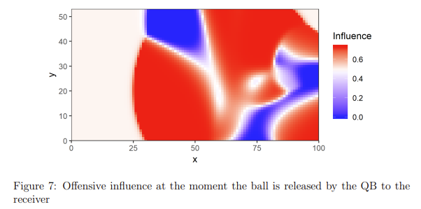
Modern History of Statistics in Sports
Firehose/Player Tracking Era: 2015ish-Now
Football: Player Tracking data
Source: https://statsbylopez.netlify.app/post/r-for-nfl-analysis; https://operations.nfl.com/media/3670/big-data-bowl-sfu.pdf

Slide 16
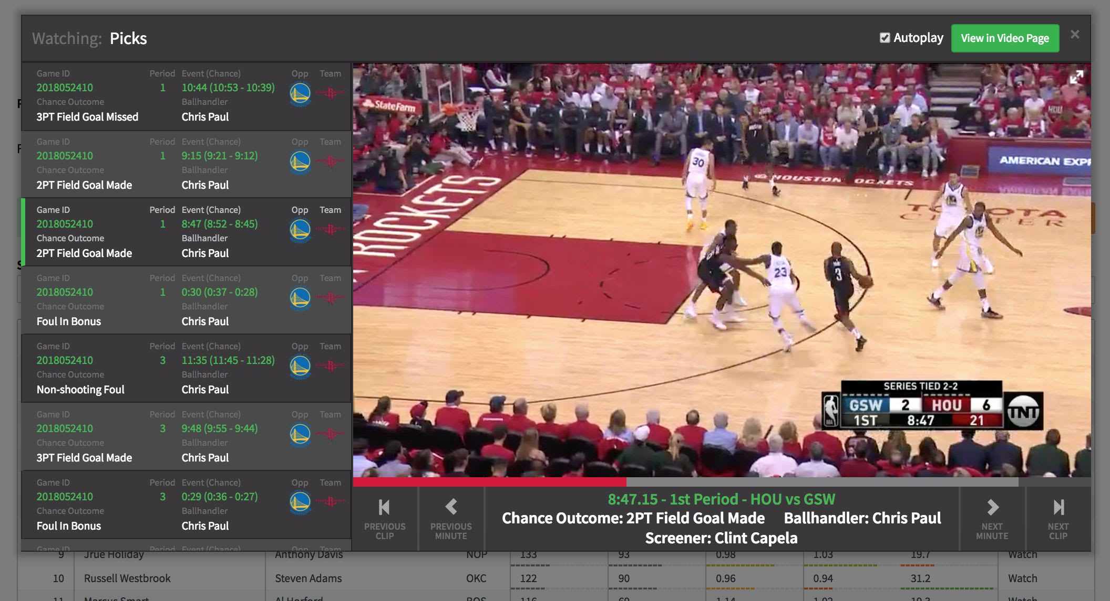
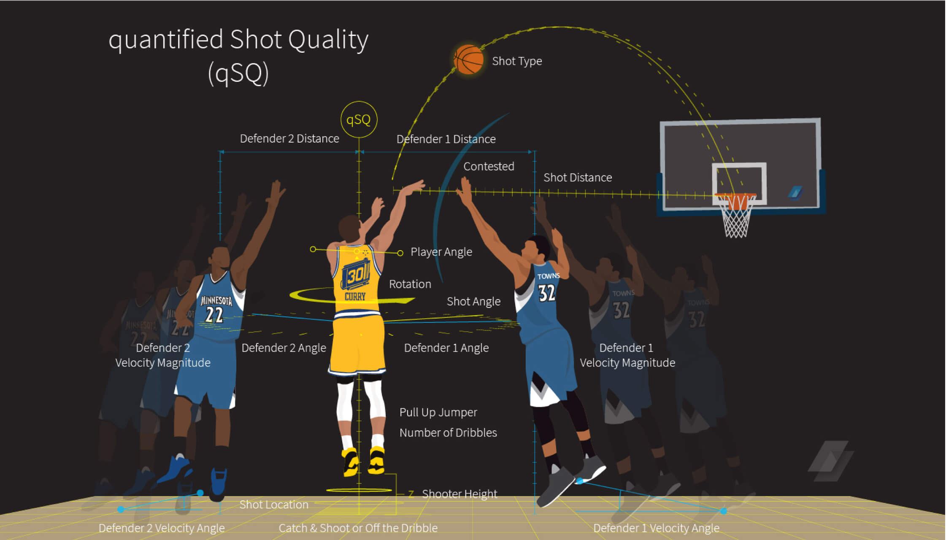
Modern History of Statistics in Sports
Firehose/Player Tracking Era: 2015ish-Now
Basketball: Second Spectrum (prev. SportVu)
Source: https://fansided.com/2018/06/28/second-spectrum-redesigning-nba/; https://www.secondspectrum.com/press/2016-05-13.html

Slide 17
(Player Valuation) Analytics in Baseball

Slide 18

Player Valuation
Focus on player valuation
Even ignoring some parts of that, like catcher defense/pitch framing
Ignores other cool topics including:
Opponent scouting (shift)
Strategy questions (should you bunt?)
Team comparisons (rankings, GOAT team)
Preventing pitching injuries
Umpire analytics
Statcast data, spin rates
Source: https://memegenerator.net/instance/47078543/liam-neeson-theres-no-time

Slide 19
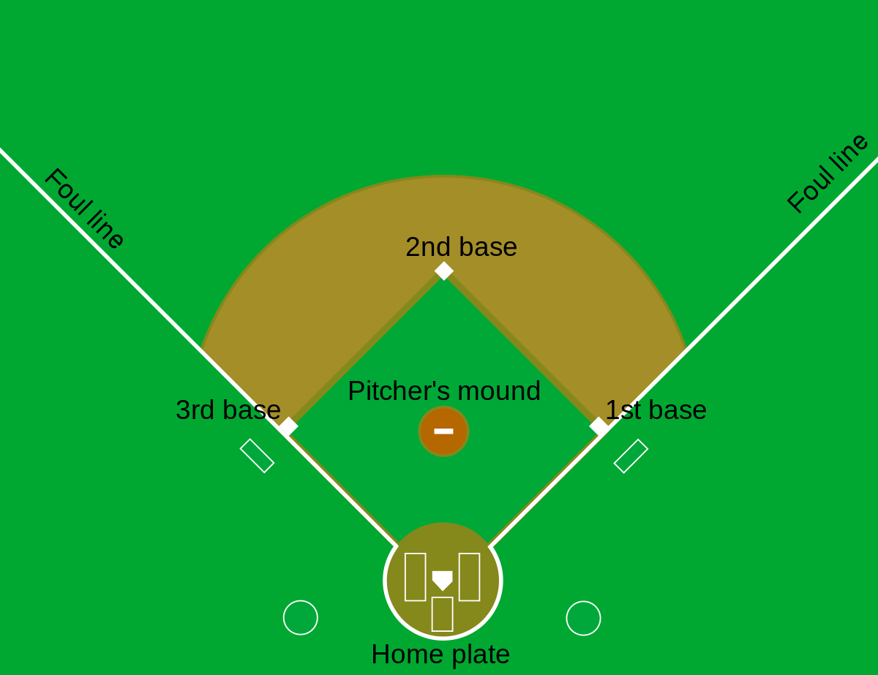
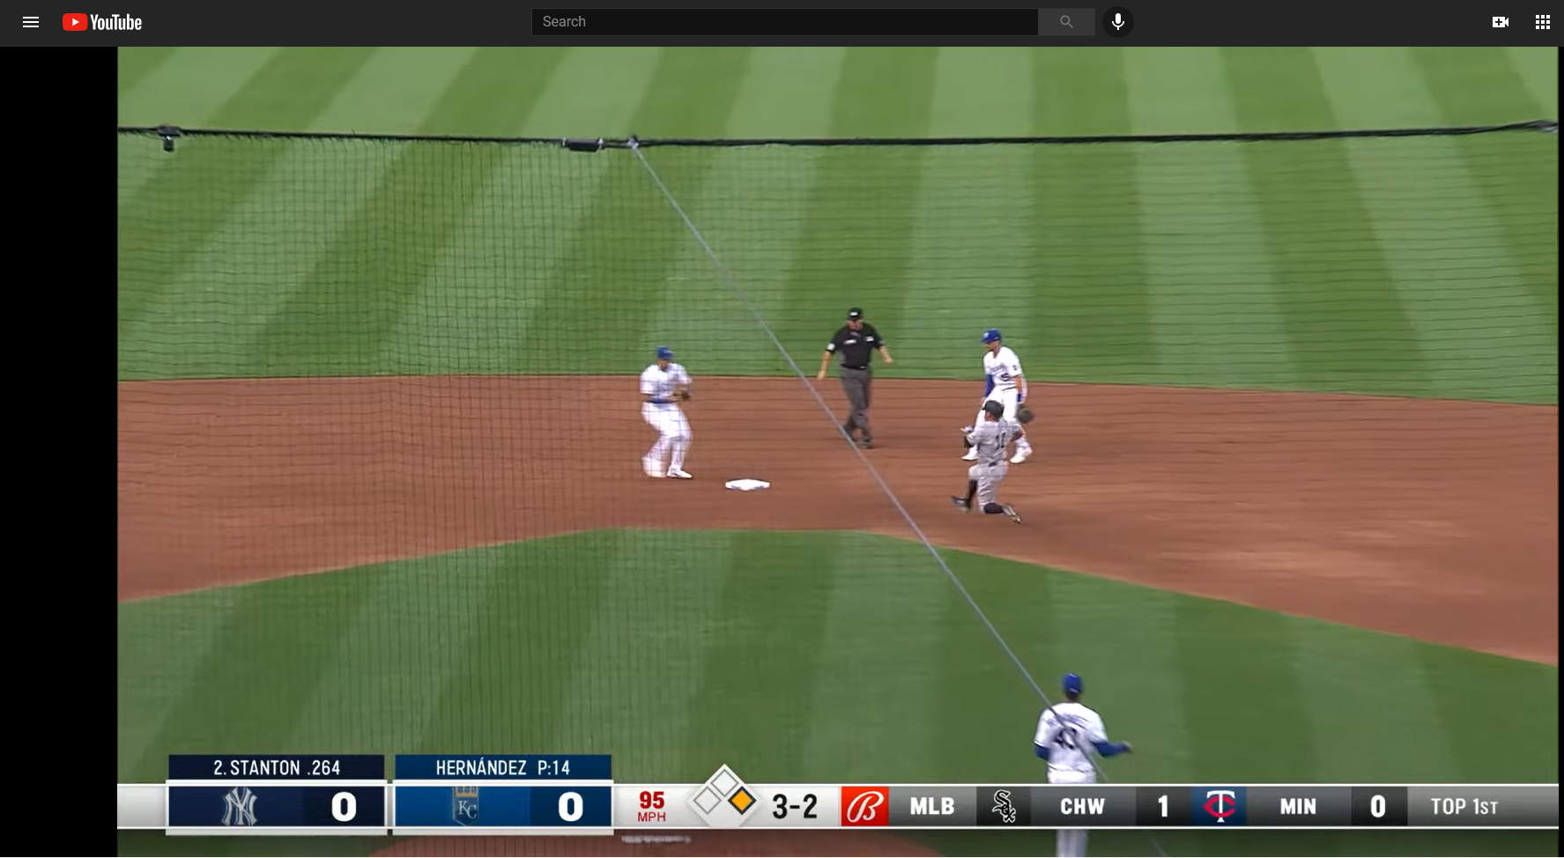
Baseball
How do you play baseball? Let’s take a look at a recent random Yankees-Royals game
Source: https://www.youtube.com/watch?v=CIYAC2PX93Y&t=19s; https://commons.wikimedia.org/wiki/File:Baseball_diamond_simplified.svg

Slide 20
Player Valuation: Defining the Question
What is player value?
Step back: what is the goal/purpose of a baseball team?

Slide 21
Batting
DISCLAIMERS: In no way even a comprehensive list of baseball batting player valuation stats
Not using Statcast data (e.g. out-of-zone swing %s)
Many different “flavors” of some stats with different formulas – we use Fangraphs

Slide 22
Batting
Runs (R) and Runs Batted In (RBIs)
Problems/Limitations? (For this and all subsequent slides, don’t look forward until I say so.)
R and RBI

Slide 23
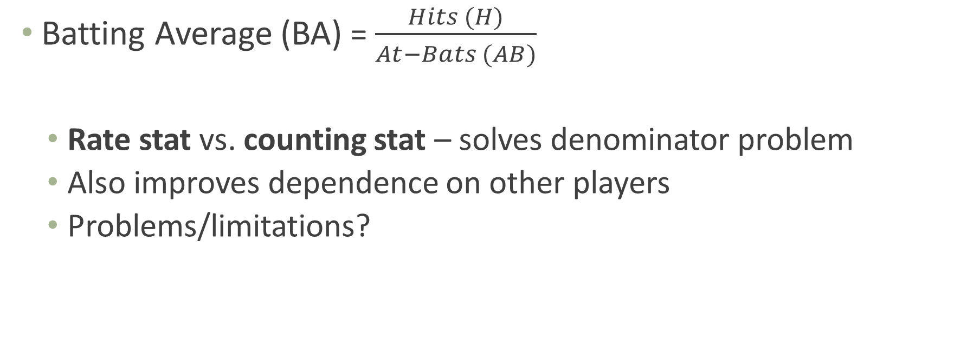
Batting
Batting Average (BA) = $\frac{Hits (H)}{At−Bats (AB)}$
Rate stat vs. counting stat – solves denominator problem
Also improves dependence on other players
Problems/limitations?
R and RBI
BA

Slide 24
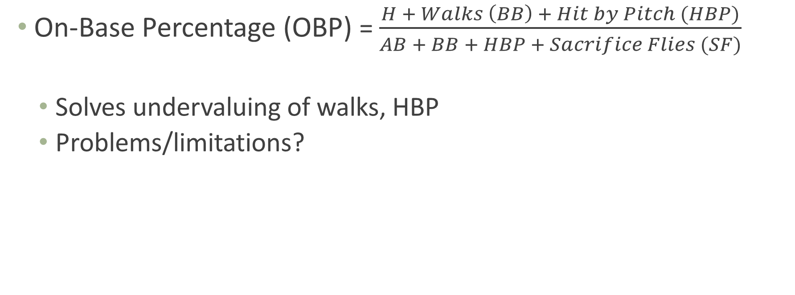
Batting
On-Base Percentage (OBP) = $\frac{H + Walks \left(BB\right) + Hit by Pitch (HBP)}{AB + BB + HBP + Sacrifice Flies (SF)}$
Solves undervaluing of walks, HBP
Problems/limitations?
≈ Plate Appearances (PA)
R and RBI
BA
OBP

Slide 25
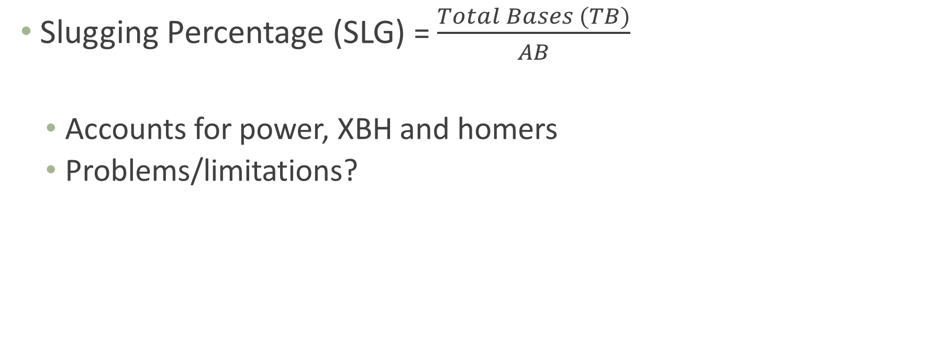
Batting
Slugging Percentage (SLG) = $\frac{Total Bases (TB)}{AB}$
Accounts for power, XBH and homers
Problems/limitations?
R and RBI
BA
SLG
OBP

Slide 26
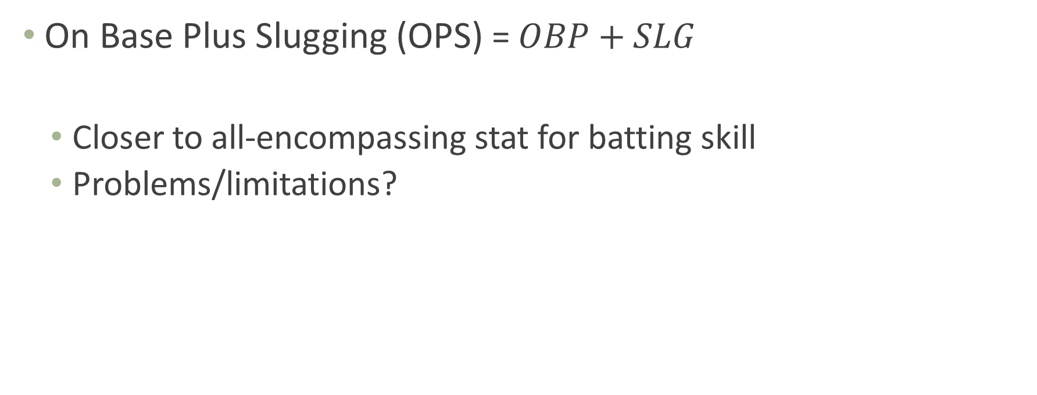
Batting
On Base Plus Slugging (OPS) = $OBP+SLG$
Closer to all-encompassing stat for batting skill
Problems/limitations?
R and RBI
BA
SLG
OBP
OPS

Slide 27
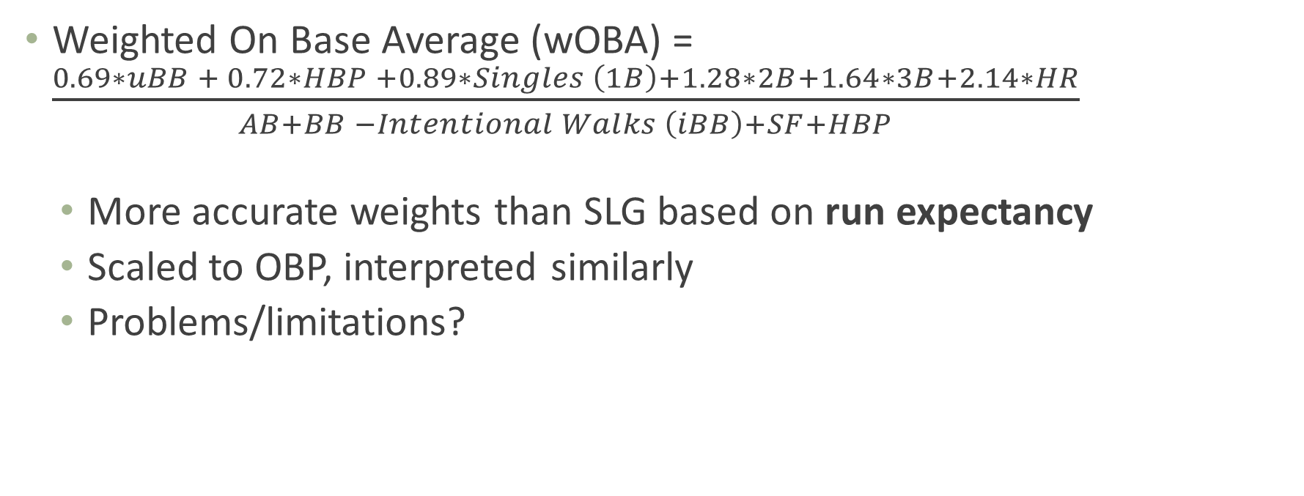
Batting
Weights vary slightly by season based on season OBP
Weighted On Base Average (wOBA) = $\frac{0.69∗uBB + 0.72∗HBP +0.89∗Singles \left(1B\right)+1.28∗2B+1.64∗3B+2.14∗HR}{AB+BB −Intentional Walks \left(iBB\right)+SF+HBP}$
More accurate weights than SLG based on run expectancy
Scaled to OBP, interpreted similarly
Problems/limitations?
R and RBI
BA
SLG
OBP
wOBA
OPS

Slide 28
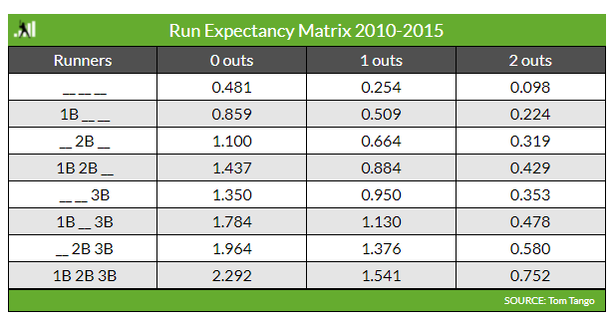
Run Expectancy
Run Expectancy (RE): every PA moves you from one state to another
Ex.: leadoff single goes from 0.481 to 0.859 → worth 0.378 expected runs
Average over all singles → RE for singles, which is (part of) the singles weight for wOBA
Source: https://library.fangraphs.com/the-beginners-guide-to-deriving-woba/

Slide 29
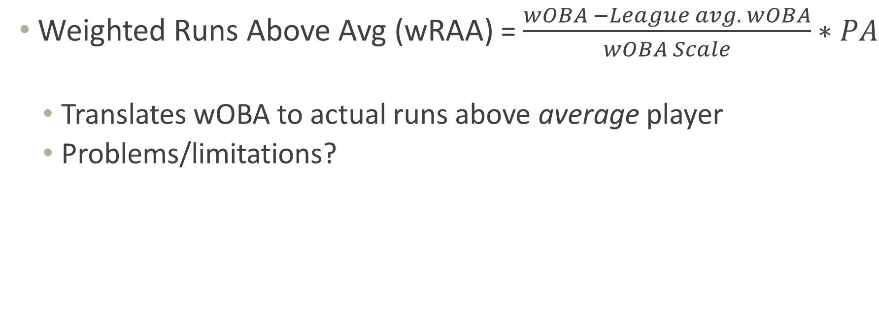
Batting
Weighted Runs Above Avg (wRAA) = $\frac{wOBA −League avg. wOBA}{wOBA Scale}∗PA$
Translates wOBA to actual runs above average player
Problems/limitations?
Undoes scaling so wOBA represents actual expected runs
R and RBI
BA
SLG
OBP
wRAA
wOBA
OPS

Slide 30
Batting
(Batting) Wins Above Replacement (WAR) = Complicated
Adjusts for park, league, position; compares to replacement player
Then translates runs to wins (1 win ≈ 9-10 runs)
Ultimate value. How much $ is a win worth x (total) WAR = contract value
R and RBI
BA
SLG
OBP
wRAA
wOBA
WAR
OPS

Slide 31
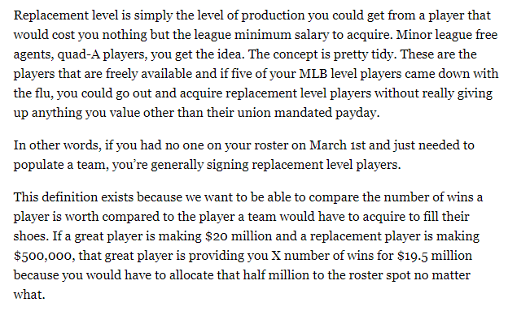
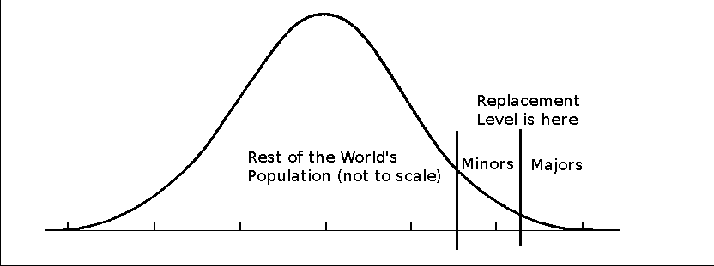
Replacement Level
Replacement Level:
Source: https://library.fangraphs.com/misc/war/replacement-level/; https://www.baseball-reference.com/about/war_explained.shtml

Slide 32
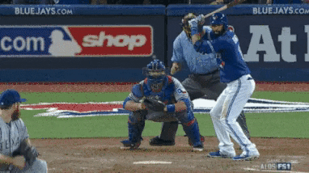
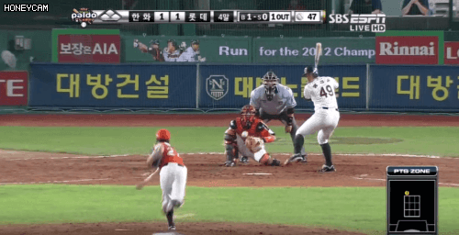
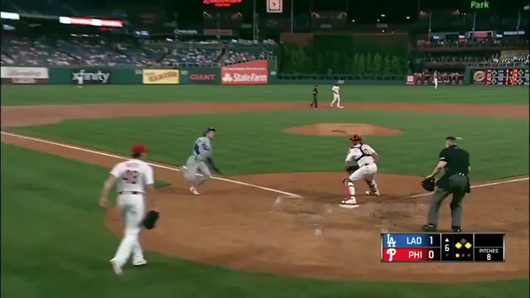
“Let’s See Your Stats Capture This”
Source: https://gfycat.com/shallowscarcegermanspitz-los-angeles-trea-turner-baseball-dodgers; http://hyunyrun.blogspot.com/2020/05/kbo-bat-flip-collection-gif.html; https://giphy.com/explore/bat-flip

Slide 33
Fielding
Errors
Problems/Limitations?
Errors

Slide 34
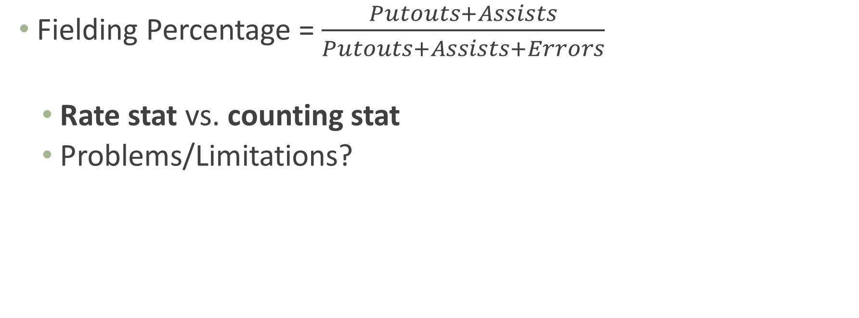
Fielding
Fielding Percentage = $\frac{Putouts+Assists}{Putouts+Assists+Errors}$
Rate stat vs. counting stat
Problems/Limitations?
Errors
Fielding %age

Slide 35
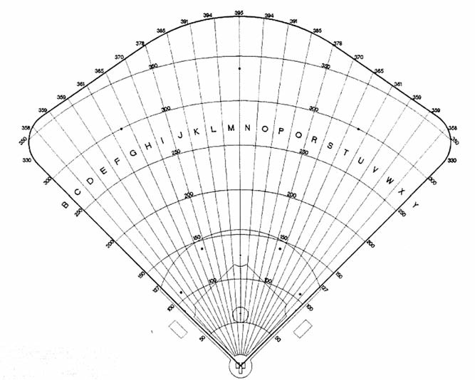
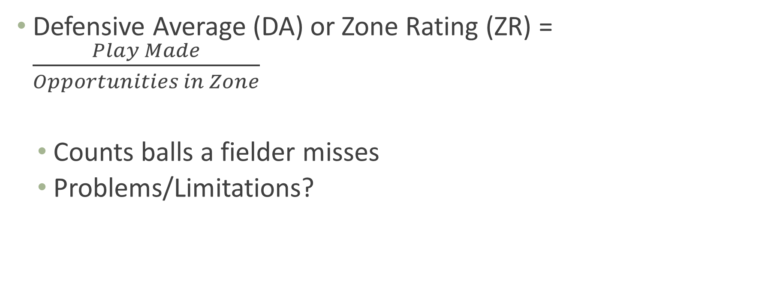
Fielding
Defensive Average (DA) or Zone Rating (ZR) = $\frac{Play Made}{Opportunities in Zone}$
Counts balls a fielder misses
Problems/Limitations?
Turned ball into an out
Errors
Fielding %age
Defensive Average / Zone Rating
Source: https://sabr.org/journal/article/measuring-defense-entering-the-zones-of-fielding-statistics/

Slide 36
Fielding
Ultimate Zone Rating (UZR): extremely complicated
Accounts for park, skill turning double plays, outfield assists; just generally more comprehensive
Translates to runs saved
Problems/Limitations?
Errors
Fielding %age
UZR
Defensive Average / Zone Rating

Slide 37
Fielding
(Fielding) WAR = Complicated, again
Translates UZR runs to wins (1 win ≈ 9-10 runs); treats catchers separately (steals and passed balls prevented); adjusts for position
Ultimate value. How much $ is a win worth x (total) WAR = contract value
Errors
Fielding %age
UZR
Defensive Average / Zone Rating
WAR

Slide 38
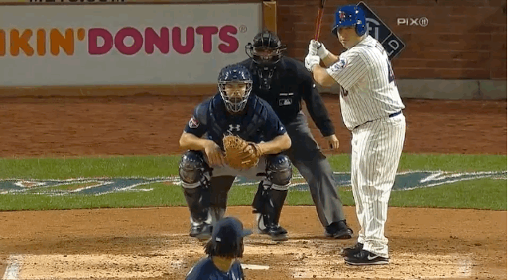
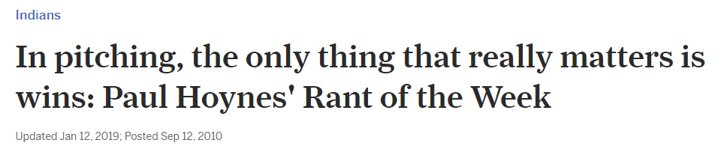
Pitching
Wins (or Win-Loss Record, W-L)
Problems/limitations?
W-L
Source: https://www.cleveland.com/tribe/2010/09/in_pitching_all_that_matters_a.html; https://nesn.com/2014/04/mets-pitcher-bartolo-colon-swings-hard-misses-pitch-loses-helmet-gif/

Slide 39
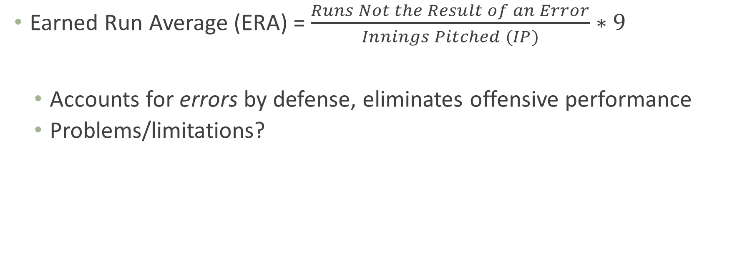
Pitching
Earned Run Average (ERA) = $\frac{Runs Not the Result of an Error}{Innings Pitched (IP)}∗9$
Accounts for errors by defense, eliminates offensive performance
Problems/limitations?
W-L
ERA

Slide 40
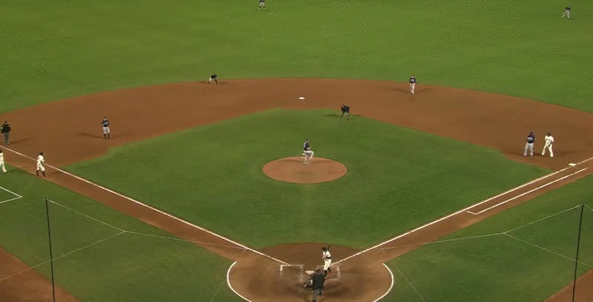
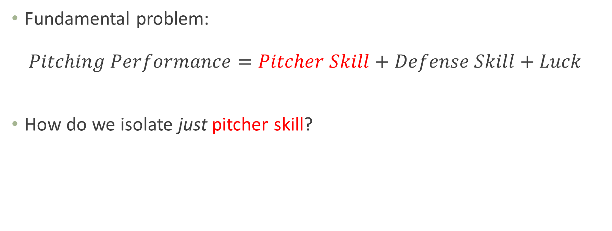
Breaking Down Pitching Performance
Fundamental problem: $Pitching Performance=Pitcher Skill+Defense Skill+Luck$
How do we isolate just pitcher skill?
Enter Defense-Independent Pitching Statistics (DIPS) – despite name, try to deal with defensive skill and luck
Source: https://i.gifer.com/OOxX.gif

Slide 41
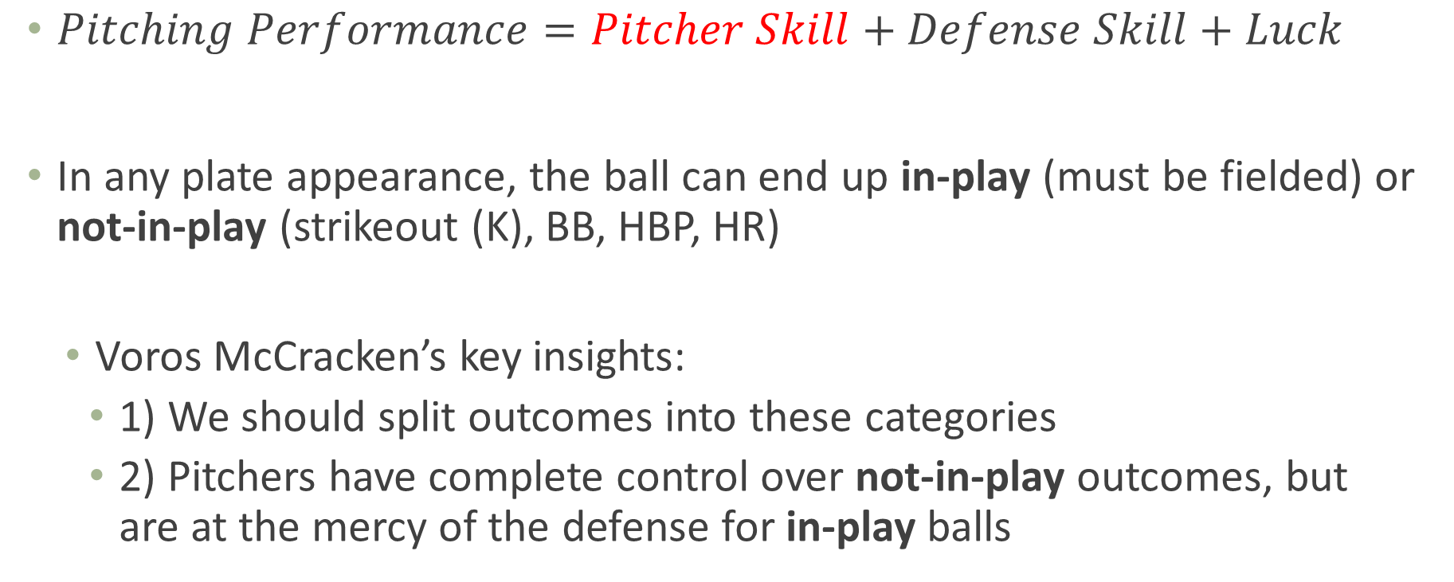
Breaking Down Pitching Performance
$Pitching Performance=Pitcher Skill+Defense Skill+Luck$
In any plate appearance, the ball can end up in-play (must be fielded) or not-in-play (strikeout (K), BB, HBP, HR)
Voros McCracken’s key insights:
1) We should split outcomes into these categories
2) Pitchers have complete control over not-in-play outcomes, but are at the mercy of the defense for in-play balls

Slide 42
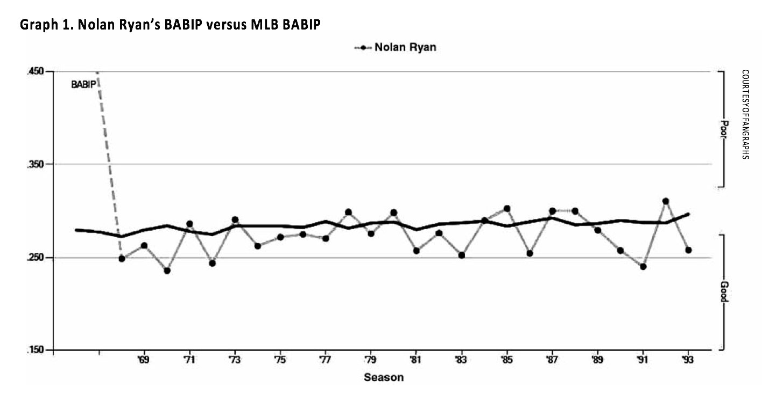
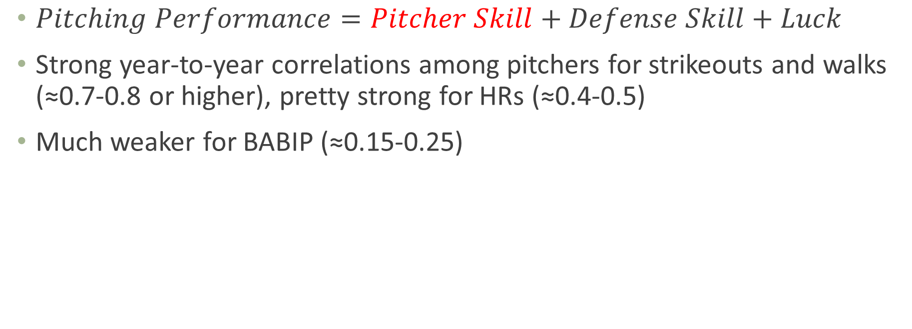
Batting Average on Balls in Play (BABIP)
$Pitching Performance=Pitcher Skill+Defense Skill+Luck$
Strong year-to-year correlations among pitchers for strikeouts and walks (≈0.7-0.8 or higher), pretty strong for HRs (≈0.4-0.5)
Much weaker for BABIP (≈0.15-0.25)
Source: http://sabr.org/journal/article/the-many-flavors-of-dips-a-history-and-an-overview/

Slide 43
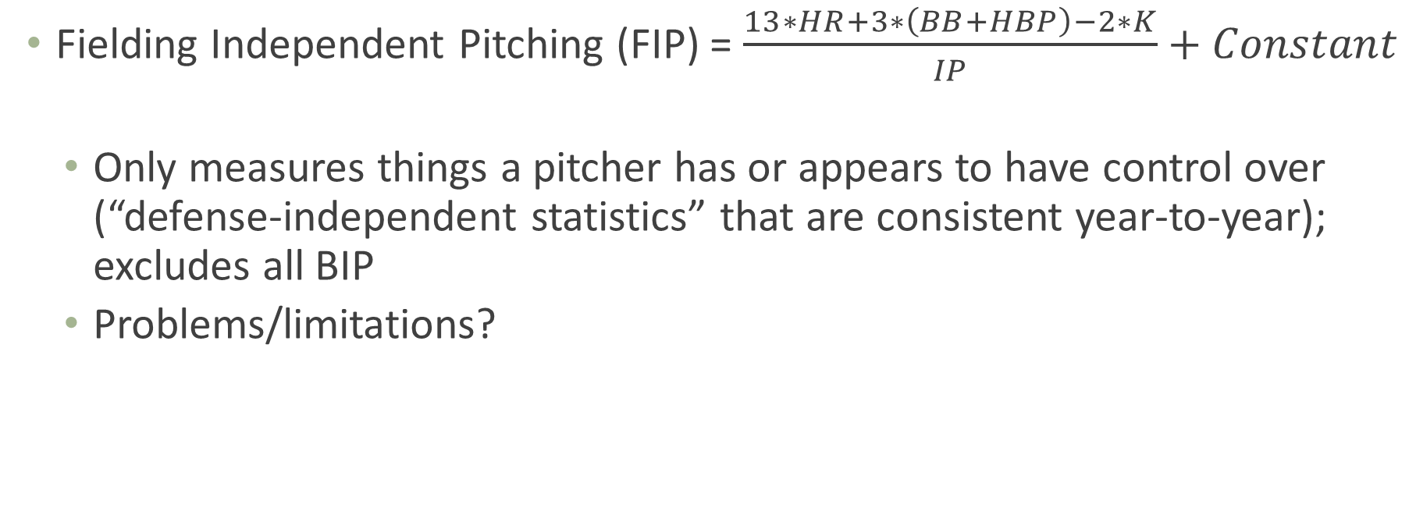
Pitching
To make FIP read like ERA
Fielding Independent Pitching (FIP) = $\frac{13∗HR+3∗\left(BB+HBP\right)−2∗K}{IP}+Constant$
Only measures things a pitcher has or appears to have control over (“defense-independent statistics” that are consistent year-to-year); excludes all BIP
Problems/limitations?
W-L
ERA
DIPS (FIP)

Slide 44

Ground and Fly Balls
Of course it’s not really that simple
Pitchers don’t control overall BABIP, but do control:
% ground balls (GB)
% fly balls (FB)
Ratio GB/FB
Etc.
Stats like tRA, QERA, SIERA take this batted ball data into account
In-season vs. next season projections
Source: https://medium.com/@mxoliverleigh/really-it-should-not-be-this-complicated-fd8a13056747

Slide 45
Pitching
(Pitching) WAR = Complicated, again
Adds infield flies to FIP, translates to runs, adjusts for park and league, then translates to wins (but here every pitcher has a different runs per win metric), compares to replacement level
Remember this is Fangraphs WAR; other sources may use something other than FIP as basis
Ultimate value. How much $ is a win worth x (total) WAR = contract value
W-L
ERA
WAR
DIPS (FIP)

Slide 46
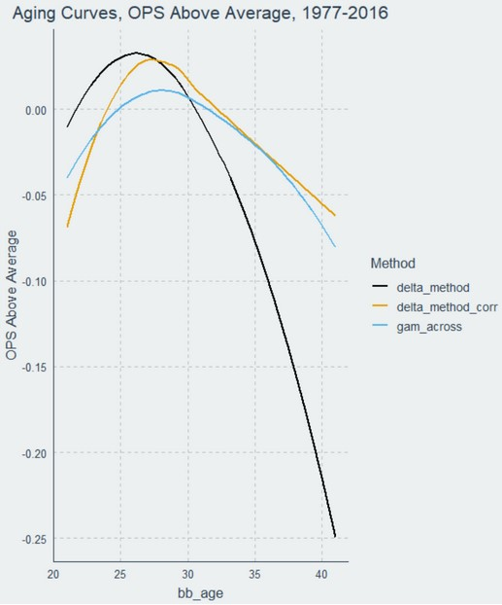
Predicting Future Value
Different from cross-sectional stats describing what an athlete is, we need to know what an athlete will be
Two challenges: 1) Try to identify a player’s true talent, and then 2) project that forward
Repeatability: look for stats that are either stable year-to-year, or at least predictive of future performance
Not luck-based
Adjust for things you know will happen (e.g. aging curves)
Source: https://www.baseballprospectus.com/news/article/59972/the-delta-method-revisited/, https://arxiv.org/abs/1802.00998

Slide 47
What Makes a Good (Sports) Statistic?

Slide 48

The Question
A statistic starts with a QUESTION
It should be designed to answer that QUESTION
A statistic may be good for one QUESTION but not another
Be transparent and explicit about what your QUESTION is and what the statistic is designed to do – and, critically, not do!
Source: https://twitter.com/bernybelvedere/status/1171435503586926593

Slide 49
Match Your Stat to Your Question
How good is this hitter? – wOBA
How good is this pitcher? – FIP
How good will this pitcher be? – SIERA

Slide 50
Match Your Stat to Your Question
Teams: How much should I pay this player? – WAR, and make sure it has predictive not just descriptive value
Fantasy Managers: Who should I draft or keep? – ZiPS Projections

Slide 51
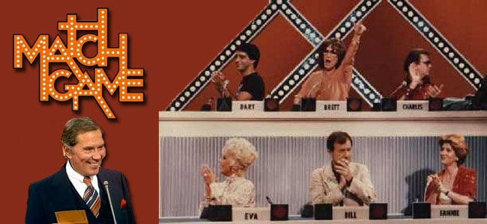
Match Your Stat to Your Question
Who’s the GOAT? – Need era-, park-, league-adjusted statistic
Some aren’t, because they’re meant for another question!!
Source: https://www.tvovermind.com/is-the-new-match-game-doing-justice-to-the-original/

Slide 52
Three Types of Questions
1. Descriptive
Describing the world as it is
2. Predictive
Describing the world as it will be
3. Causal (Counterfactual Prediction)
Describing the world as it could be

Slide 53
General Qualities of a Good Statistic
Grabiner, Sabermetric Manifesto:
1. Is the stat important for success in the sport?
2. Does it capture/isolate an individual player’s contribution?
Pre-supposes a player valuation QUESTION!
3. Is there a better alternative to measure what you’re trying to measure?
We’ll add:
4. Is it repeatable/stable?
Is it measuring signal or noise? “True talent” or luck?
Source: http://www.seanlahman.com/baseball-archive/sabermetrics/sabermetric-manifesto/

Slide 54
Better Alternatives, and the Scientific Process
3. Is there a better alternative to measure what you’re trying to measure?
Science is built on accumulating small answers that lead to big insights – “get a little less wrong each day”
No single analysis answers everything – understand and accept that
BUT sometimes an analysis is worse than no analysis at all; judgement call
CDC MMWR from Provincetown: vaccinated vs. unvaccinated viral loads with COVID delta variant

Slide 55
Assessing Our Baseball Statistics
1. Is the stat important for success in the sport?
Batting | Fielding | Pitching
R or RBIs | Errors | W-L
BA | Fielding Average | ERA
OBP | Defensive Average/Zone Rating | FIP
SLG | UZR | (Pitching) WAR
OPS | (Fielding) WAR
wOBA
wRAA
(Batting) WAR

Slide 56
Assessing Our Baseball Statistics
2. For player valuation questions: does it capture/isolate an individual player’s contribution?
Which depend on player’s: Teammates? Ballpark? Era?
Batting | Fielding | Pitching
R or RBIs | Errors | W-L
BA | Fielding Average | ERA
OBP | Defensive Average/Zone Rating | FIP
SLG | UZR | (Pitching) WAR
OPS | (Fielding) WAR
wOBA
wRAA
(Batting) WAR

Slide 57
Assessing Our Baseball Statistics
3. Is there a better alternative to measure what you’re trying to measure?
Batting | Fielding | Pitching
R or RBIs | Errors | W-L
BA | Fielding Average | ERA
OBP | Defensive Average/Zone Rating | FIP
SLG | UZR | (Pitching) WAR
OPS | (Fielding) WAR
wOBA
wRAA
(Batting) WAR

Slide 58
Assessing Our Baseball Statistics
4. Is it repeatable/stable
Is it measuring signal or noise? “True talent” or luck?
Batting | Fielding | Pitching
R or RBIs | Errors | W-L
BA | Fielding Average | ERA
OBP | Defensive Average/Zone Rating | BABIP
SLG | UZR | FIP
OPS | (Fielding) WAR | (Pitching) WAR
wOBA
wRAA
(Batting) WAR

Slide 59

Thanks!
Questions? zbinney@emory.edu, @binney_z on Twitter

